Slide 1
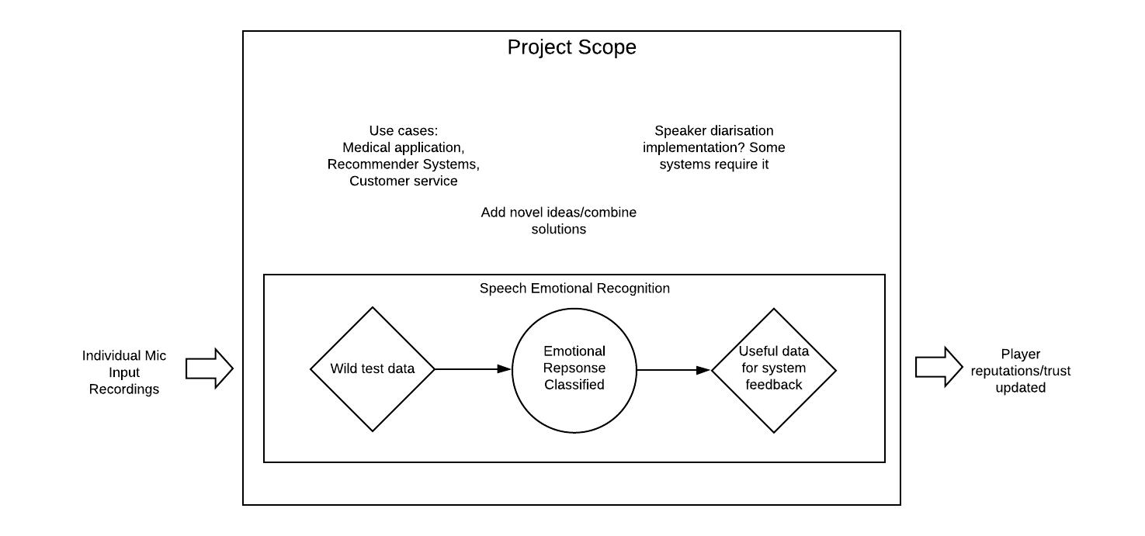
Emotional Speech Recognition

Slide 2
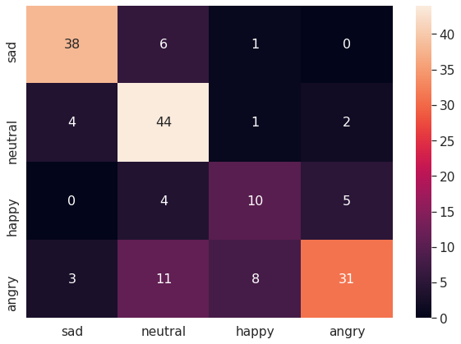
Initial Experiments
Utilising RAVDESS currently, goals moving forward -
todo:
Add Emo-DB, TESS datasets
Perform new grid search (MLP best methodology?)
Ammend dataset loading methods (we want all data regardless of filtering emotions?)
Research improvements in training, ensure no overfit
Data fundamentals plotting lecture notes

Slide 3
Initial Experiments (cont.)
Feature Extraction:
- MFCC (mfcc)Mel-frequency cepstral coefficients (MFCCs)
- Chroma (chroma) STFT Compute a chromagram from a waveform or power spectrogram.
- MEL Spectrogram Frequency (mel)Compute a mel-scale spectrogram.
- Contrast (contrast)Compute spectral contrast
- Tonnetz (tonnetz)Computes the tonal centroid features (tonnetz)

Slide 4
Q & A
Is this scope sufficient for project? Allows for system based evaluation focus
Suggestions for expansion/depth potential
Broaden implications of project, could implement speaker diarisation alongside emotional classifier?
Other features to extract from datasets? Network types?
Deployment to be a future goal if time permits, python code available to test via mic input, discordpy implementation?
General things to note vs. my time with matlab, audio analysis?

